Slide 1
CHY 6015 \ RCN 20010027
Notes:
Notes for teachers:
Barnardos is Ireland’s largest children’s charity and we help transform the lives of vulnerable children. Our mission is that all children in Ireland get to reach their potential. With support from Google.org, the Barnardos Online Safety Programme delivers workshops or webinars in schools to children aged 8-12 about how to be safe online. These workshops take a positive approach to online safety, asking children to be S.T.A.R.s online and to learn 4 simple rules to be safe, resilient and positive online.
S – stay safe online
T- think smart
A – ask for help
R is for reach out and be kind
To compliment these 45 minute workshops/webinars, we’ve also developed these lesson plans for teachers to help expand on the messages we’ve given. When schools are closed due to Covid restrictions, these video lessons also act as stand alone lessons, or blended learning. This is the final lesson that looks at R is for Reach out and Be Kind. The video for children is about 10-15 minutes long. These slides have the same content but are for teachers/educators. There is a worksheet that compliments the lesson and it has activities attached to it.
This lesson looks at two things:
Explaining what cyberbullying is
Explaining how to reach out and be kind to others online: how to be an upstander

Slide 2
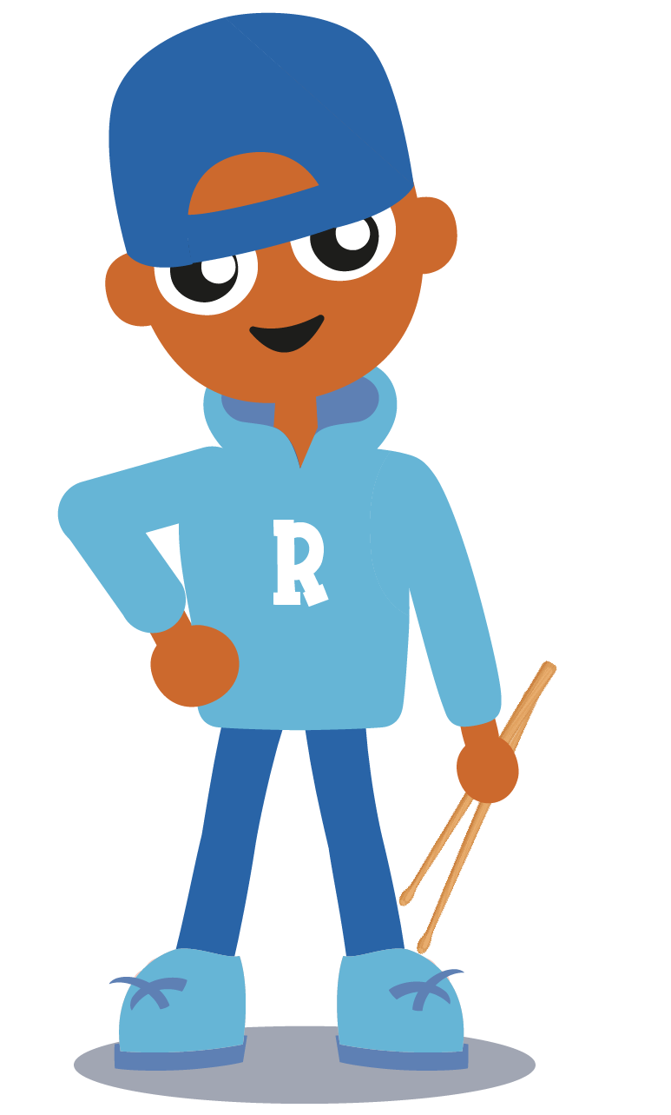
This is Rob
Notes:
1 min
Key message: This lesson is about online behaviour and tries to show you how to use the internet in a positive way. It looks at cyberbullying and shows you ways to reach out and be kind to others online.
This is Rob. He is the drummer in our online safety band and unfortunately he has had a hard time online online. Sometimes he doesn’t always understand if people are joking on the internet and he reacts very angrily. In this lesson, we hope to help Rob understand what cyberbullying is and how to help others online by reaching out and being kind to them.

Slide 3
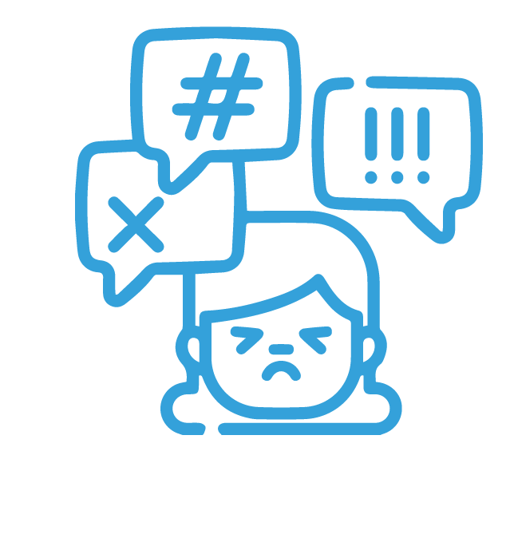
Cyberbullying: what it is, why people do it, what to do if it happens to you
How to be an upstander: how to reach out to others and be kind
Notes:
1 mins
Key messages: Objectives of the lesson
There are two parts to this lesson. As we said, it is to help Rob understand people’s online behaviour. 1) We will look at cyberbullying – what it is, why people do it and what to do if it happens to you. 2) how to be an upstander – how to reach out and be kind to others and use the internet in a positive way.

Slide 4
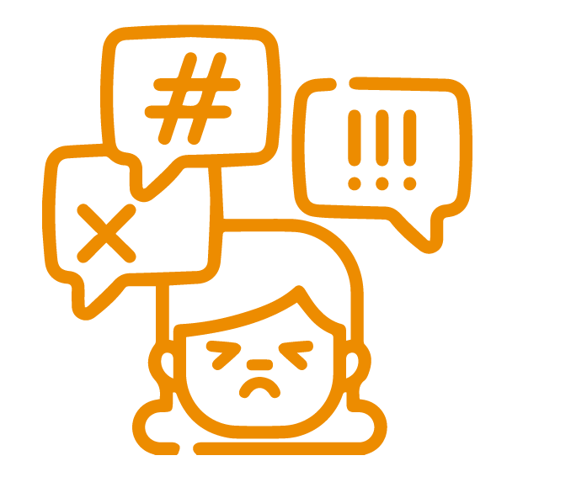
What is Bullying?
“Bullying is the behaviour of a person or group of people who hurt or frighten someone smaller or less powerful, often forcing that person to do something they don’t want to do.”
Bullying is repeated, and it is on purpose.
Notes:
2 mins
Key messages: definition of bullying
What is bullying? Can anyone define it?
According to the Cambridge English dictionary, bullying Is
https://dictionary.cambridge.org/dictionary/english/bullying
If I say something mean to you once – is that bullying? NO. Bullying behaviour happens again and again and it is NOT an accident.

Slide 5
Do activity 1 on your worksheet
In what ways can people bully?
Notes:
2 mins
Key messages: in what ways can people bully?
On your worksheet, fill out activity 1 whereby it asks you the different ways that people can bully (Physical bullying (hitting/punching), Emotional bullying (Saying mean things/calling names), Online bullying (bullying using technology or on the internet)
In pairs, or on your own, fill out the 3 different tables with examples of how people can bully in different ways.

Slide 6
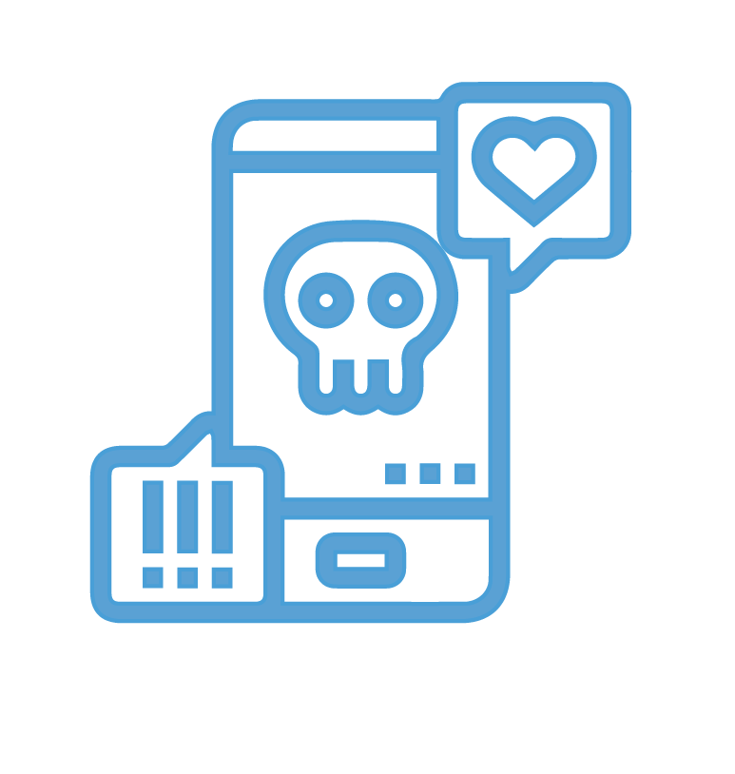
Responses to Worksheet 1
Physical abuse
Emotional abuse
Online bullying
Mean messages/comments online or through technology
Making fake accounts in other people’s names
Sending embarrassing
photos/videos
Making humiliating memes of someone else
Hitting
Kicking
Punching
Pinching
Throwing things at
Say mean things
Not including people in games
Being quiet when someone
comes into the room
Laughing/making fun of someone else
Notes:
2 mins
Key messages: Feedback to worksheet
Let’s correct the worksheet together – what did people say for physical abuse?

Slide 7
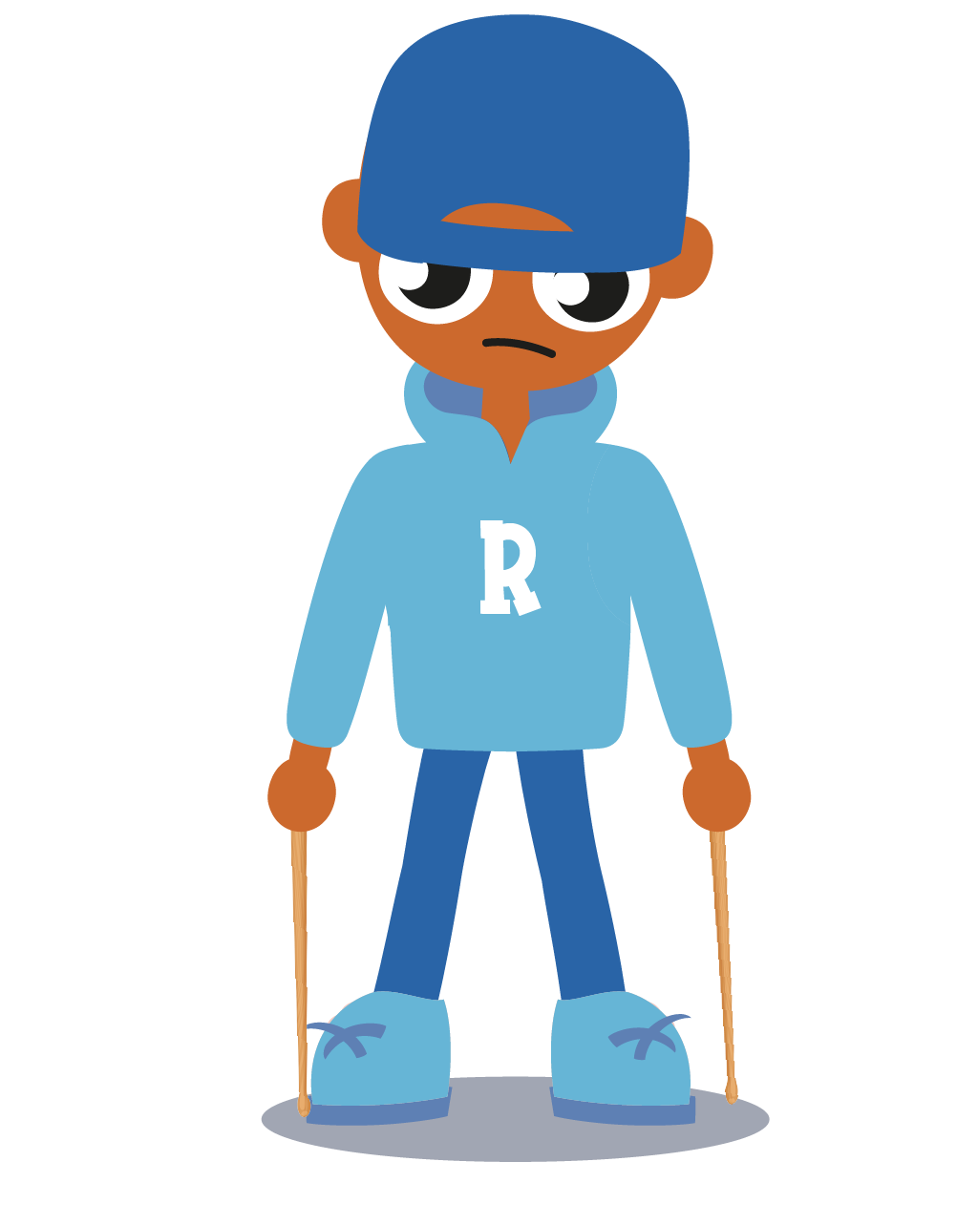
Why do some people bully?
Children can bully for a number of reasons:
Low self-esteem
Changes at home
Poor communication skills
Wanting to show off
Poor understanding of the feelings of others
It’s not you, it’s them!
Notes:
2 mins
Key messages: Understanding why some people bully in the first place?
Why do you think people bully?

Slide 8
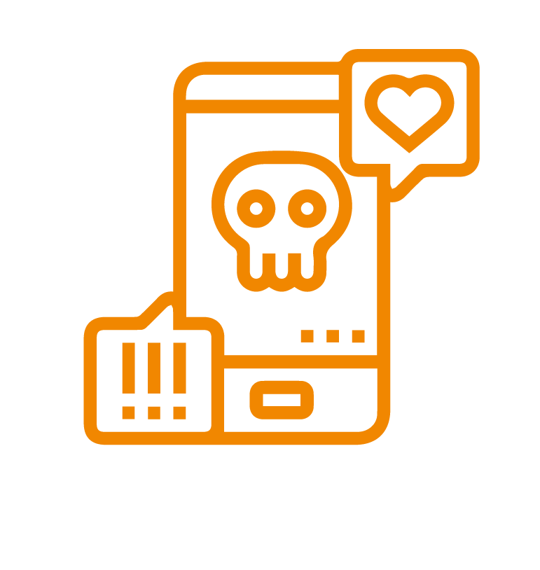
Definition of online bullying/cyberbullying
“Online bullying is using the internet or technology to harm or frighten another person, especially by sending them mean messages.”
https://dictionary.cambridge.org/dictionary/english/cyberbullying
Cambridge English Dictionary
Notes:
1 mins
Key message: definition of cyberbullying
Today’s lesson is all about reaching out to others on the internet – so it is really looking at online bullying. We’ve looked already at online bullying and you’ve given examples of how online bullying can happen.
Can anyone give me a definition of cyberbullying?

Slide 9
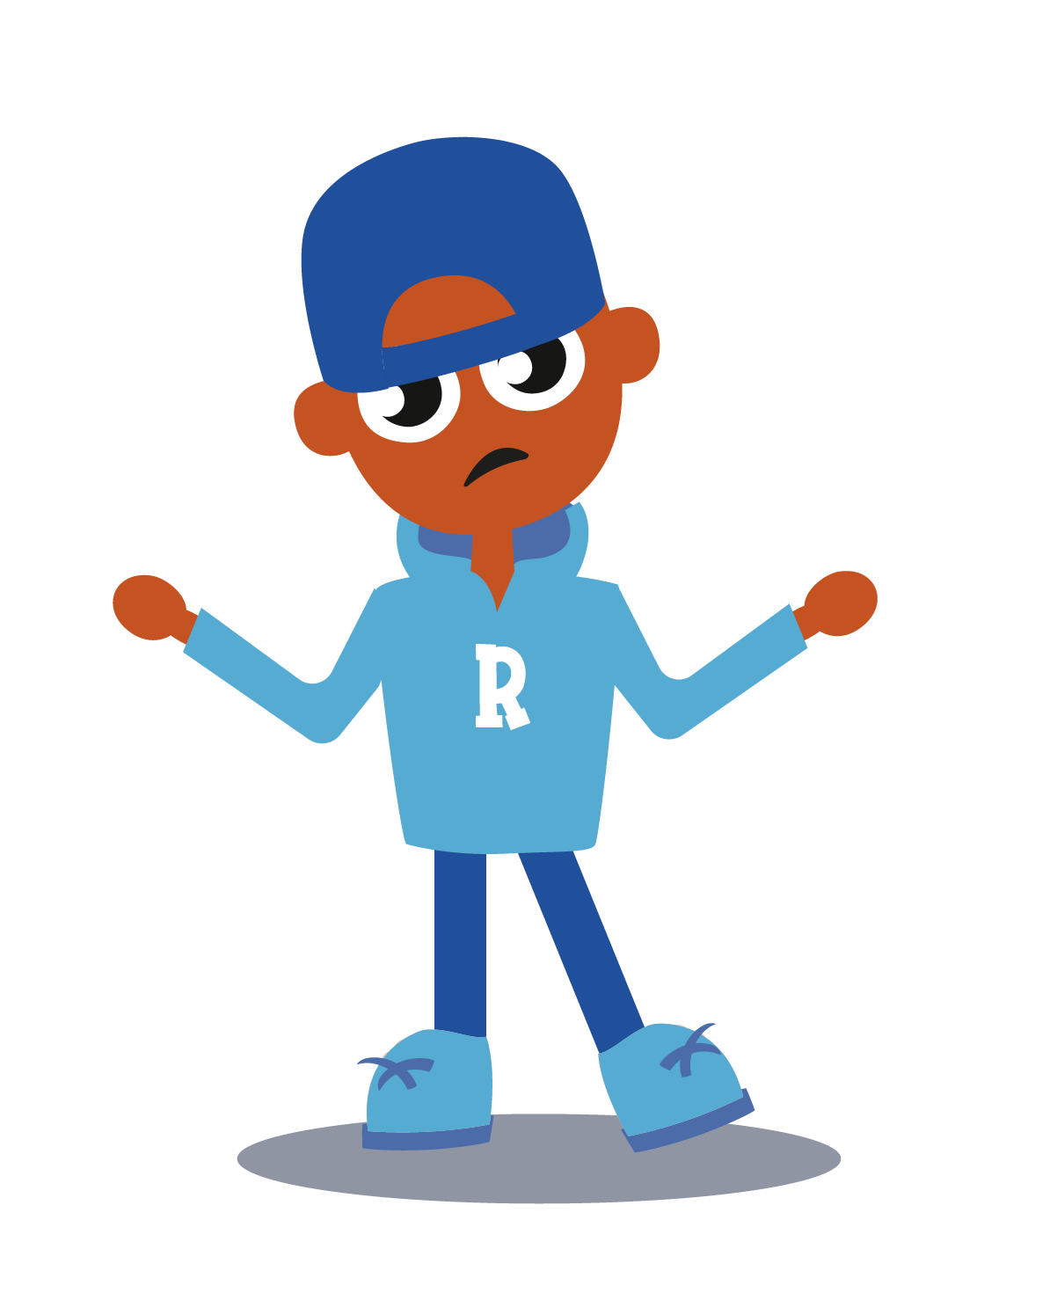
How is online bullying different to bullying?
The context is gone – you can’t see people’s true reactions
24/7: It follows you home
Can be anonymous
Messages can be distorted online: if you post online, you’ve lost control
Can come from multiple accounts
Can be ‘viral’ – audience can be larger
Notes:
3 mins
Key messages: Although bullying is bullying, the context is different online
How is online bullying different to traditional bullying? Can anyone give me examples?
Things can be misunderstood online. You might send what you think is a nice or a funny message. But because the receiver can’t see your face when they get the message, they might misunderstand the message and get upset or confused.
It follows you home: If you’re at school and someone is being mean to you there. When you’re at home, you should be safe as the bully isn’t with you. With cyberbullying, this isn’t the case. The bullying can happen anytime – even at night time.
Can by anonymous – in face to face bullying, you know who is being mean to you because you can see them. With cyberbullying, people hide behind screens and make new avatars and usernames so you don’t actually know who the bullies are.
Can come from multiple accounts – in the same way, you can get lots of mean messages as they can all come from separate acccounts so it can be very overwhelming
You lose control online – we know that once you send a message online, you lose control of it. You could send a message or an image to someone else online and they could photoshop it or change or alter it in a way that you never meant it to be. In the same way, people can make fake accounts in your name pretending to be you.
Can be viral- audience is larger – if someone is mean to you face to face, whoever is nearby you at that time will see it. But online, the audience can be a lot bigger. There could be an embarrassing photo or video of you shared online and within a few minutes hundreds or even thousands of people could see it as it can be easily shared.
Is there any way that these could come up as examples/images? It is a bit too listy. I would be doing the voice over, but like in T for think smart (virus/fake news etc), you see the example
Ex. It follows you home - image of Rob getting a message on device late at night
Ex. anonymous - message from unknown number
Ex: A real image, then the same image with obvious photoshop (change head and put in new person’s head etc)
Ex. A few messages from different accounts all being mean
Ex. A video uploaded to Youtube, but goes from 10 views to 10,000 very quickly

Slide 10
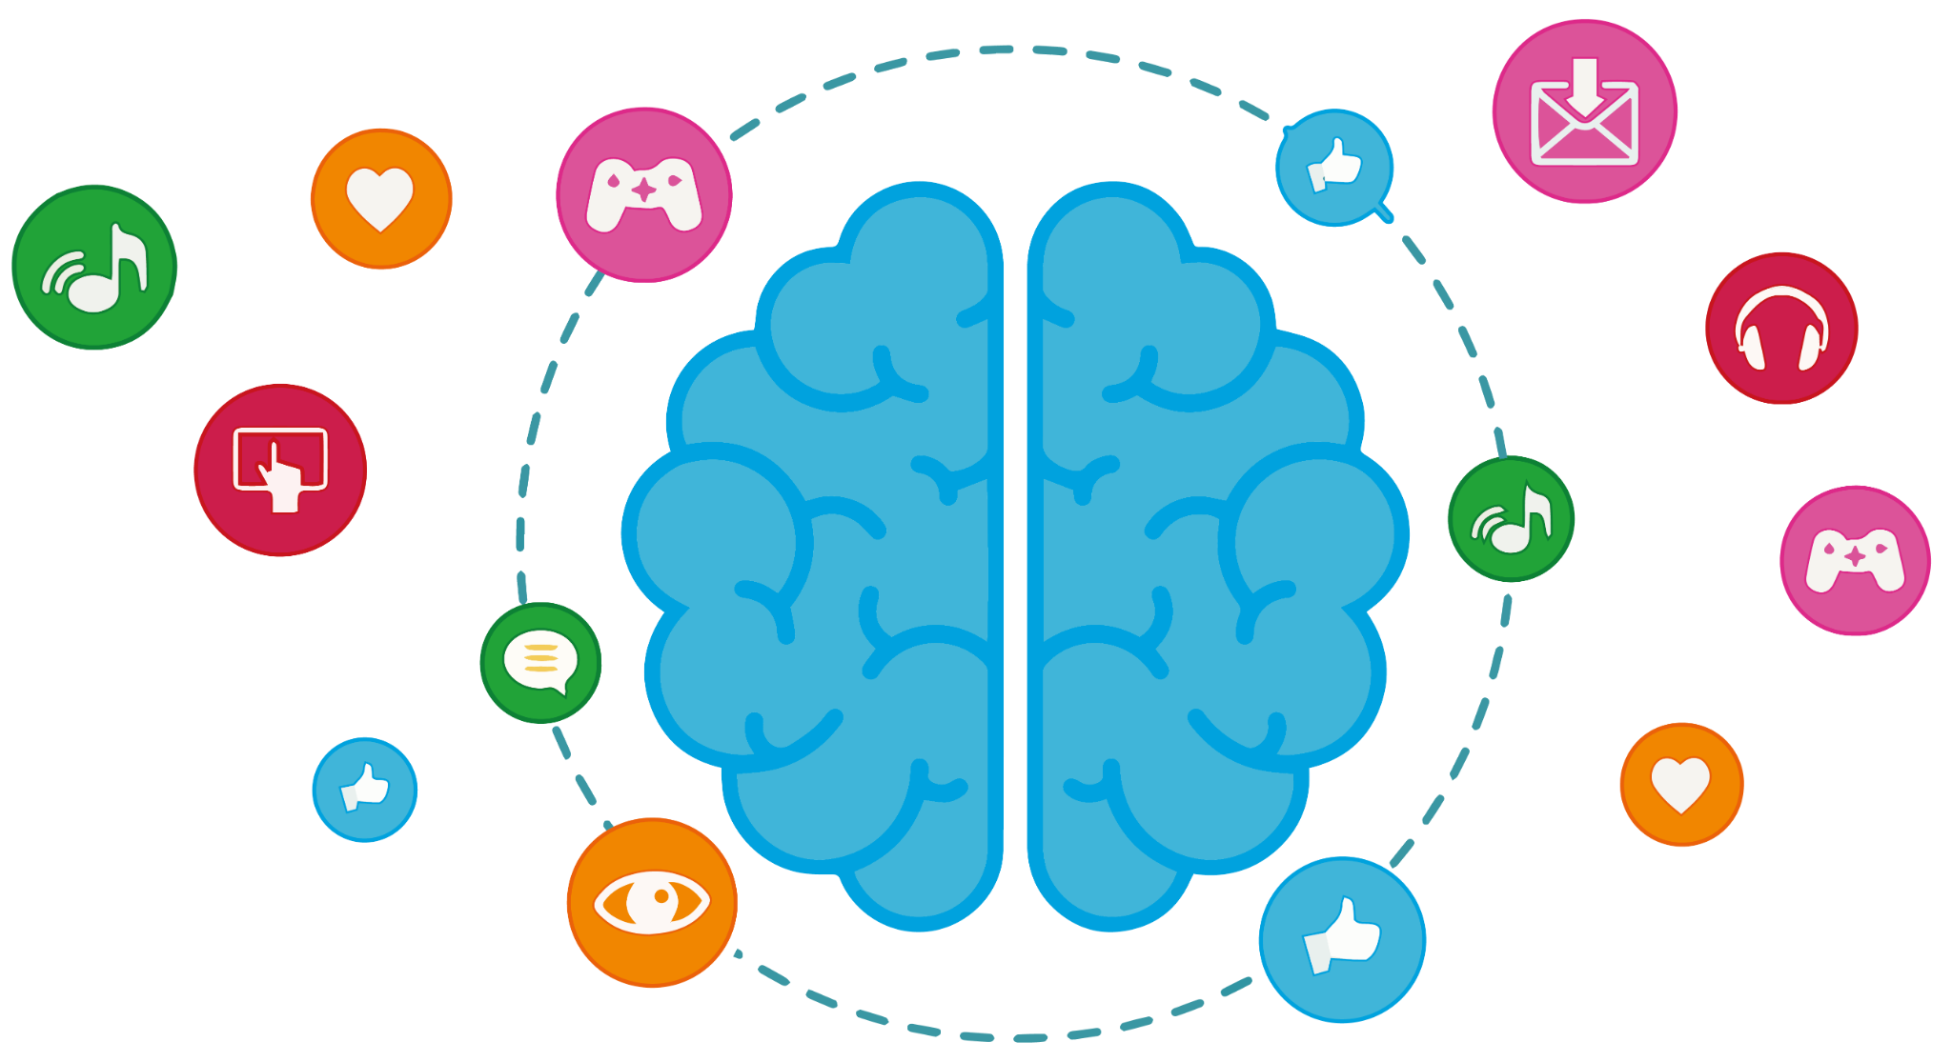
Online behaviour
Notes:
2 mins
Key messages: Why is behaviour different online?
Do you think people behave different online than they do in the real world? Do you think people are more positive or negative online? (usually more negative). Why is that? Why would people be mean online but they wouldn’t be as mean face to face?
They don’t see your face so they can’t see if you’re upset or not
They share a message or repost a video without always thinking of the consequences
They don’t always see the real-life conseqences to their actions online so they assume everyone thinks it’s a joke
Everyone puts their best life online and doesn’t always explain if they are offended or upset by things

Slide 11
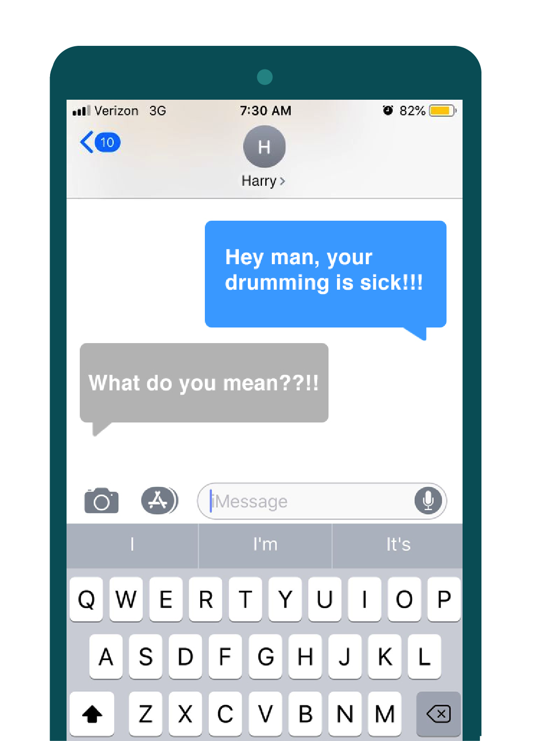
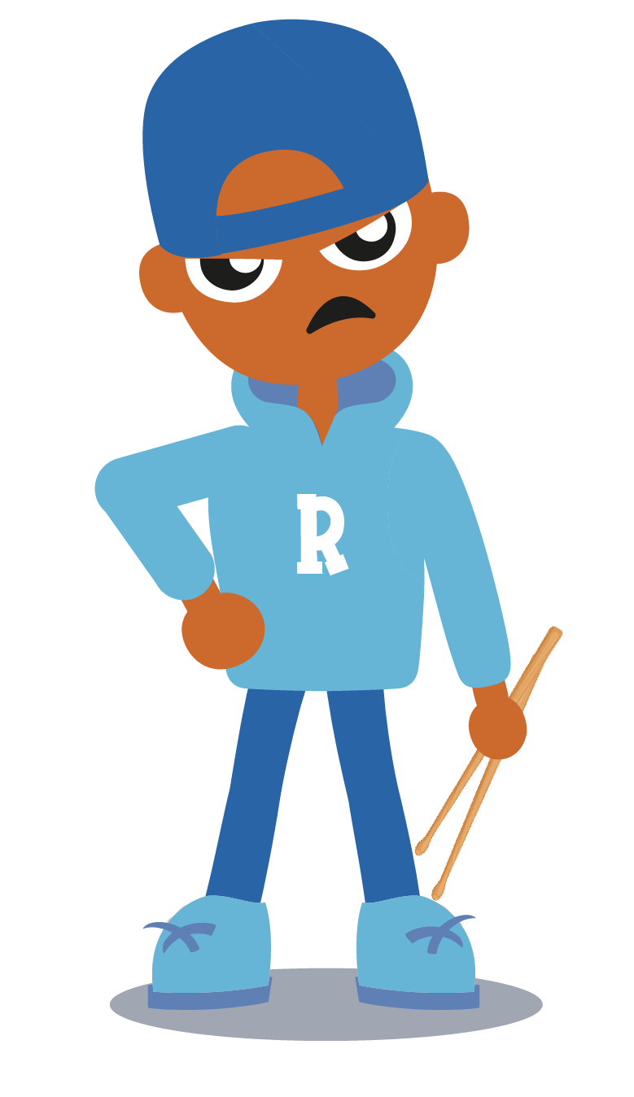
Is this banter or bullying?
Notes:
2 mins
Key messages: things can be misunderstood online. Count to 10 and don’t post when you’re angry. It is always better to clarify things face to face.
So we know that people can sometimes act without thinking online, without thinking of the consequences and how it can make others feel. It can be easy to do this as the person isn’t in front of them
In this situation Rob is a bit angry or upset as he gets this message from Harry. It says ‘hey man, your drumming is sick’. Rob writes back ‘what do you mean?!’ and he seems a bit mad.
What do you think is happening here? Do you think this is a nice message from Harry?

Slide 12
Do activity 2 on your worksheet
Which examples are cyberbullying?
Notes:
3 mins
Key messages: Which examples are cyberbullying, which are just a joke?
From our last example there with Harry and Rob, it is clear that sometimes things can be a joke for some people and not a joke for others. That’s why cyberbullying can be confusing and can cause so much hurt. In your worksheets now, do activity 2 and rank how serious these different examples are. You might think that some are fine, are not serious or not hurful. If you think that, you rank them 1. If you think they are very serious and indicate cyberbullying to you, then you rank them 5. It will be interesting to see if you and the other students in your class have the same ranking system.

Slide 13
Responses to Worksheet 2
Repeated mean messages
Sending embarrassing photos
An argument online
Sending a funny picture
Sending scary or threatening messages
A sarcastic remark
False reporting
Ganging up on you in a game
Making a fake account
Deliberately excluding people
Notes:
2 mins
Key messages: There are some examples which are definitely cyberbullying, there are others when it is unclear. It is always important to remember that what is a joke to you, might not be a joke to others so always ‘think before you post’
Repeated mean messages – definitely cyberbullying
An argument online – not cyberbullying. It is ok to disagree with others, but it is best not to be nasty about things online.
Sending embarrassing photos - yes, cyberbullying (especially if you didn’t give permission to send them)
Sending a funny picture – no, not cyberbullying
A sarcastic remark online – it depends. Sarcastic remarks are not very nice and it can depend on the situation.
Ganging up on someone in a game – yes, can be cyberbullying
Deliberately exluding people (removing them from whatsapp groups) – yes, this can be cyberbullying
False report – yes, this can be cyberbullying if it is clear that you’ve done nothing wrong and people are reporting you just to be annoying
Making a fake account – yes, this is cyberbullying

Slide 14
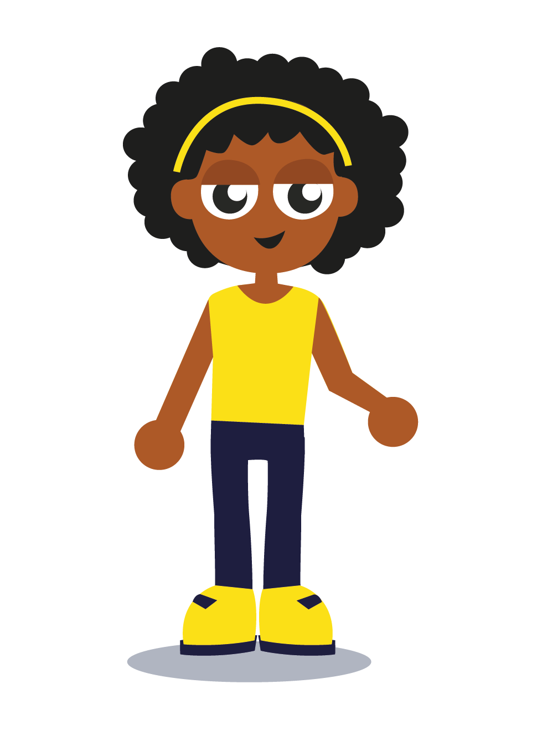
The effects of bullying
Voice over/Animation video (1.5 mins)
Notes:
Script: I’m Karen, Rob’s older sister. I’m 14 years old. I want to tell you a story about what happened to my younger brother.
Rob was so excited to get his own games console for his birthday in 6th class. He knew he could only play on it for 30 minutes a day and he was really good about this. He loved playing games with his friends, but then one day I noticed he hadn’t played on his games console for a while. I asked if anything was wrong, but he just ignored me. For a few weeks, Rob spent a lot of time in his room and said he didn’t want to go to school anymore. We were all really worried about him, but he wouldn’t tell us what was wrong.
Finally, I decided to log into his games console to see if I could find any clues about why he seemed so sad. As I was logged in as him, I started to get lots of messages. I was really shocked to see that they were really mean. Saying things like “I thought I told you to get lost and never play here again”. “You’re rubbish at this game, why do you even bother?”. “If you tell anyone about this, we will come find you”. I wrote down their usernames and logged out. I was so sad that this was happening to my brother.
I asked him very gently who the different usernames were and he just shrugged and said some people from school and strangers. Now I understood why he didn’t want to go to school anymore. I told my Mam about what I had found and she spoke to Rob about it. The next day, she went into school and told the teacher who could tell that Rob wasn’t happy in school.
I helped Rob to block and report the usernames who were being mean to him in the game and asked him if he wanted to continue playing that game or to find a new game that he liked. The teacher found out who the boys were in school and they were punished.
Things are a bit better now for Rob. I just want to say to everyone that words do hurt and just because you write them on the internet, it doesn’t mean they don’t hurt the person reading them. Always think about the person behind the screen.

Slide 15
Do activity 3 on your worksheet
What should Rob have done?
Notes:
2 mins
Key messages: What should Rob have done differently?
Rob stayed quiet and told no body about the bullying he was experiencing. What should Rob have done instead?

Slide 16
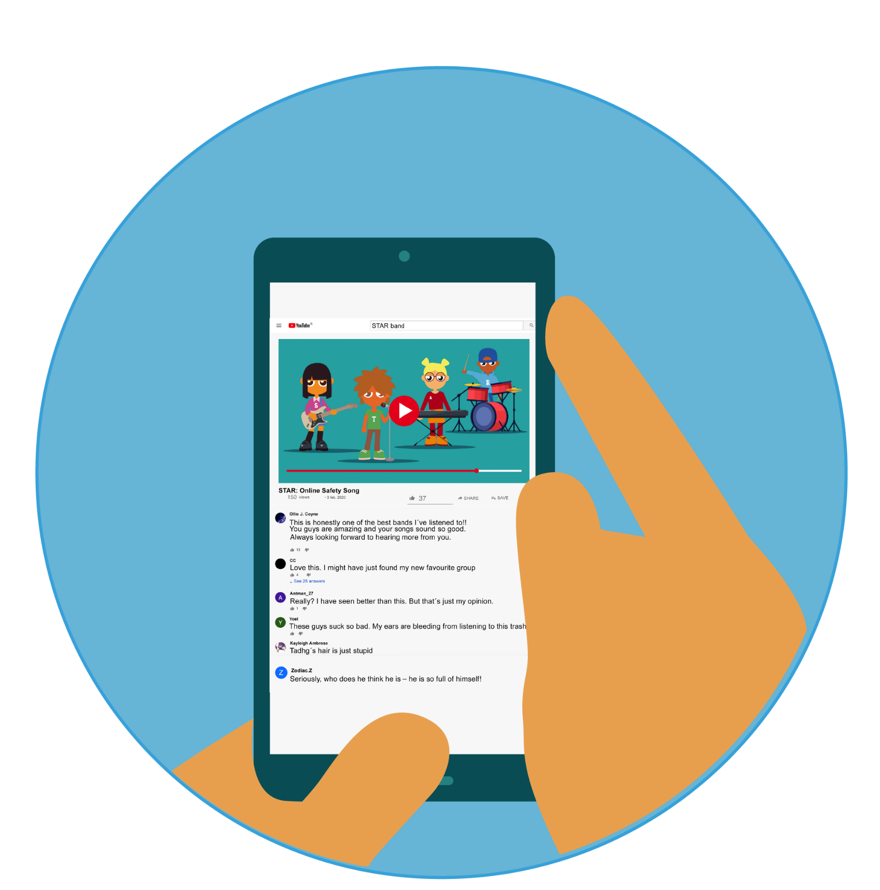
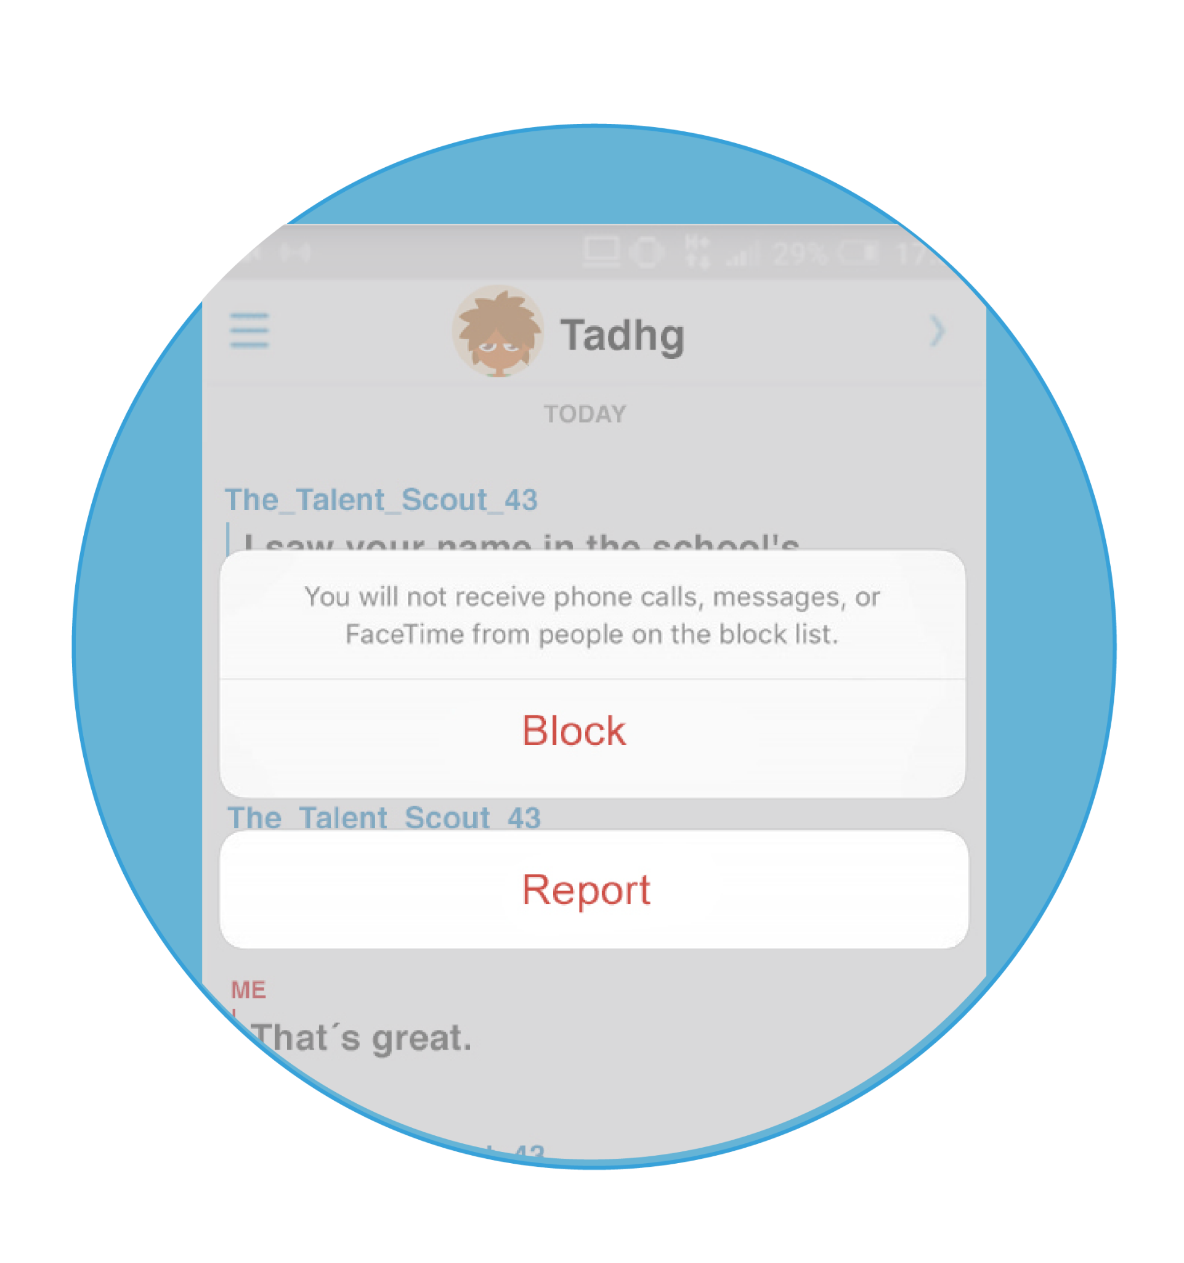
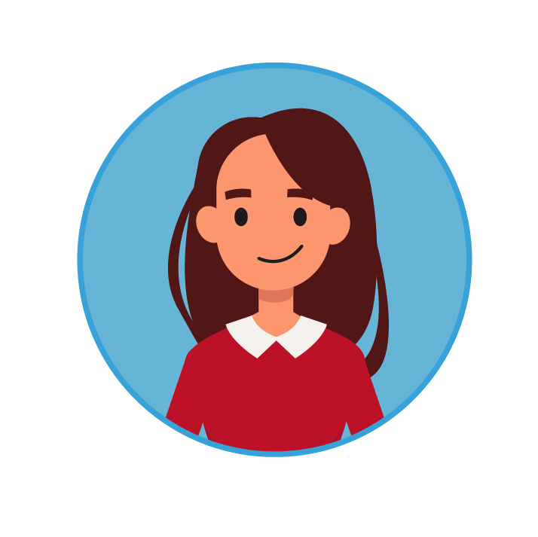
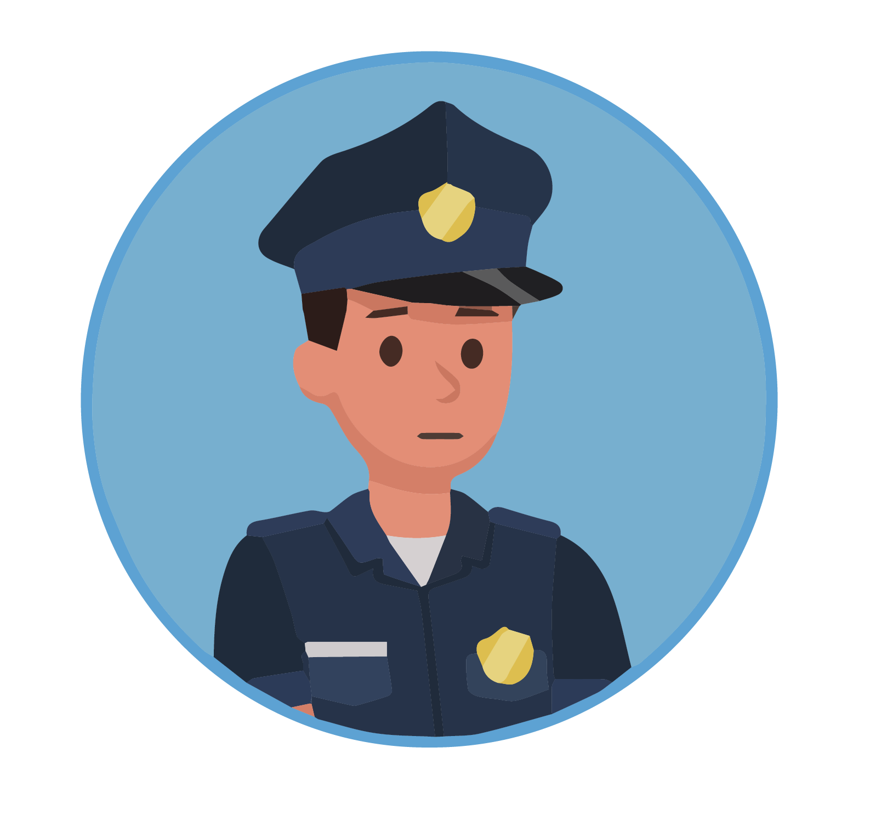
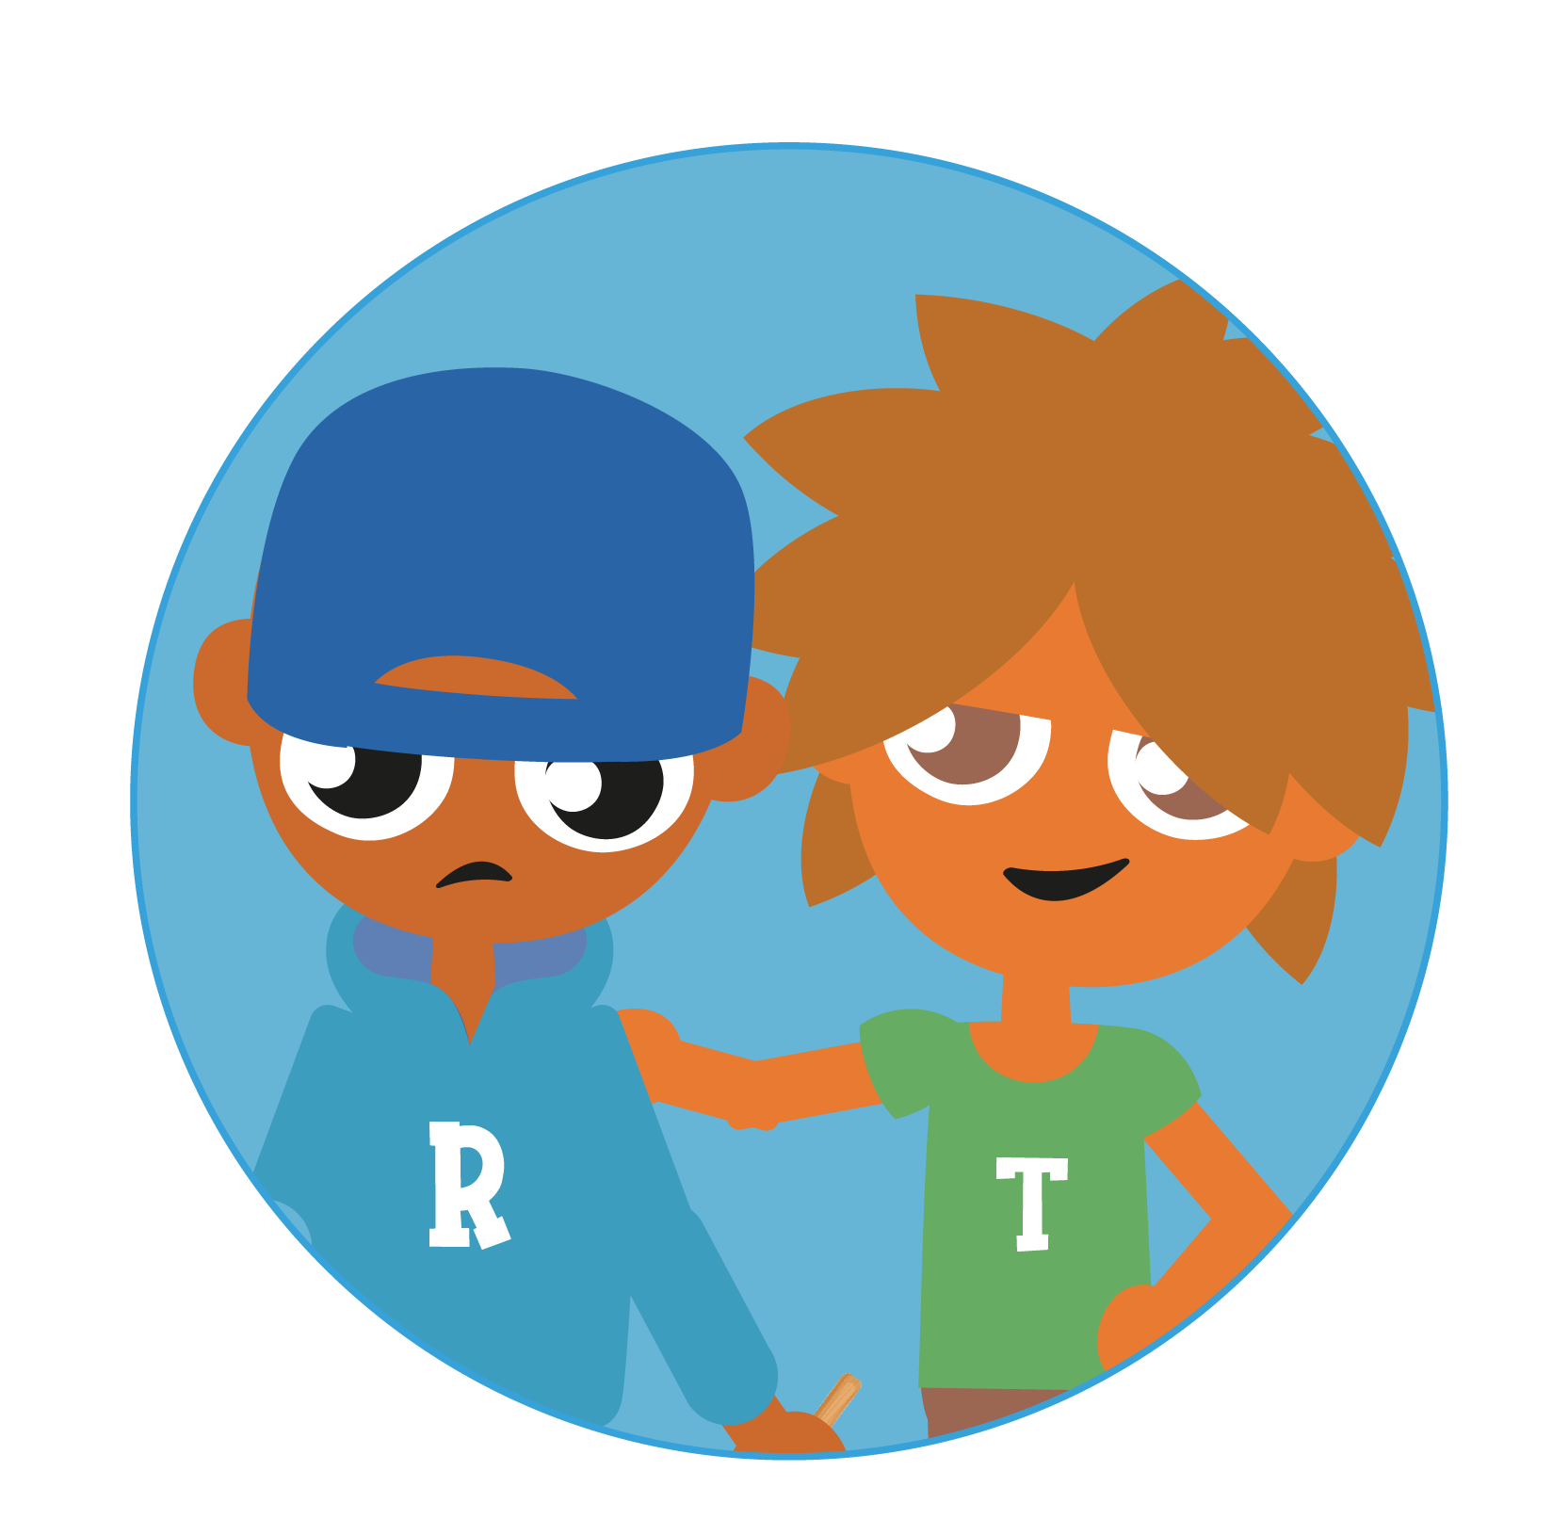
What to do when cyberbullying happens
Save the evidence
Block/report
Tell a trusted adult,
like your parents or teacher
In some situations,
the guards can be involved
Be an upstander, not a bystander
Notes:
2 mins
Key messages: What should you do if cyberbullying happens to you

Slide 17
How to be an upstander
Notes:
1 min
Key messages: How to use the internet in a positive way – how to be an upstander
We know that online bullying can ruin lives and can be really upsetting. How can we prevent this? How can we reach out and be kind to others online?

Slide 18
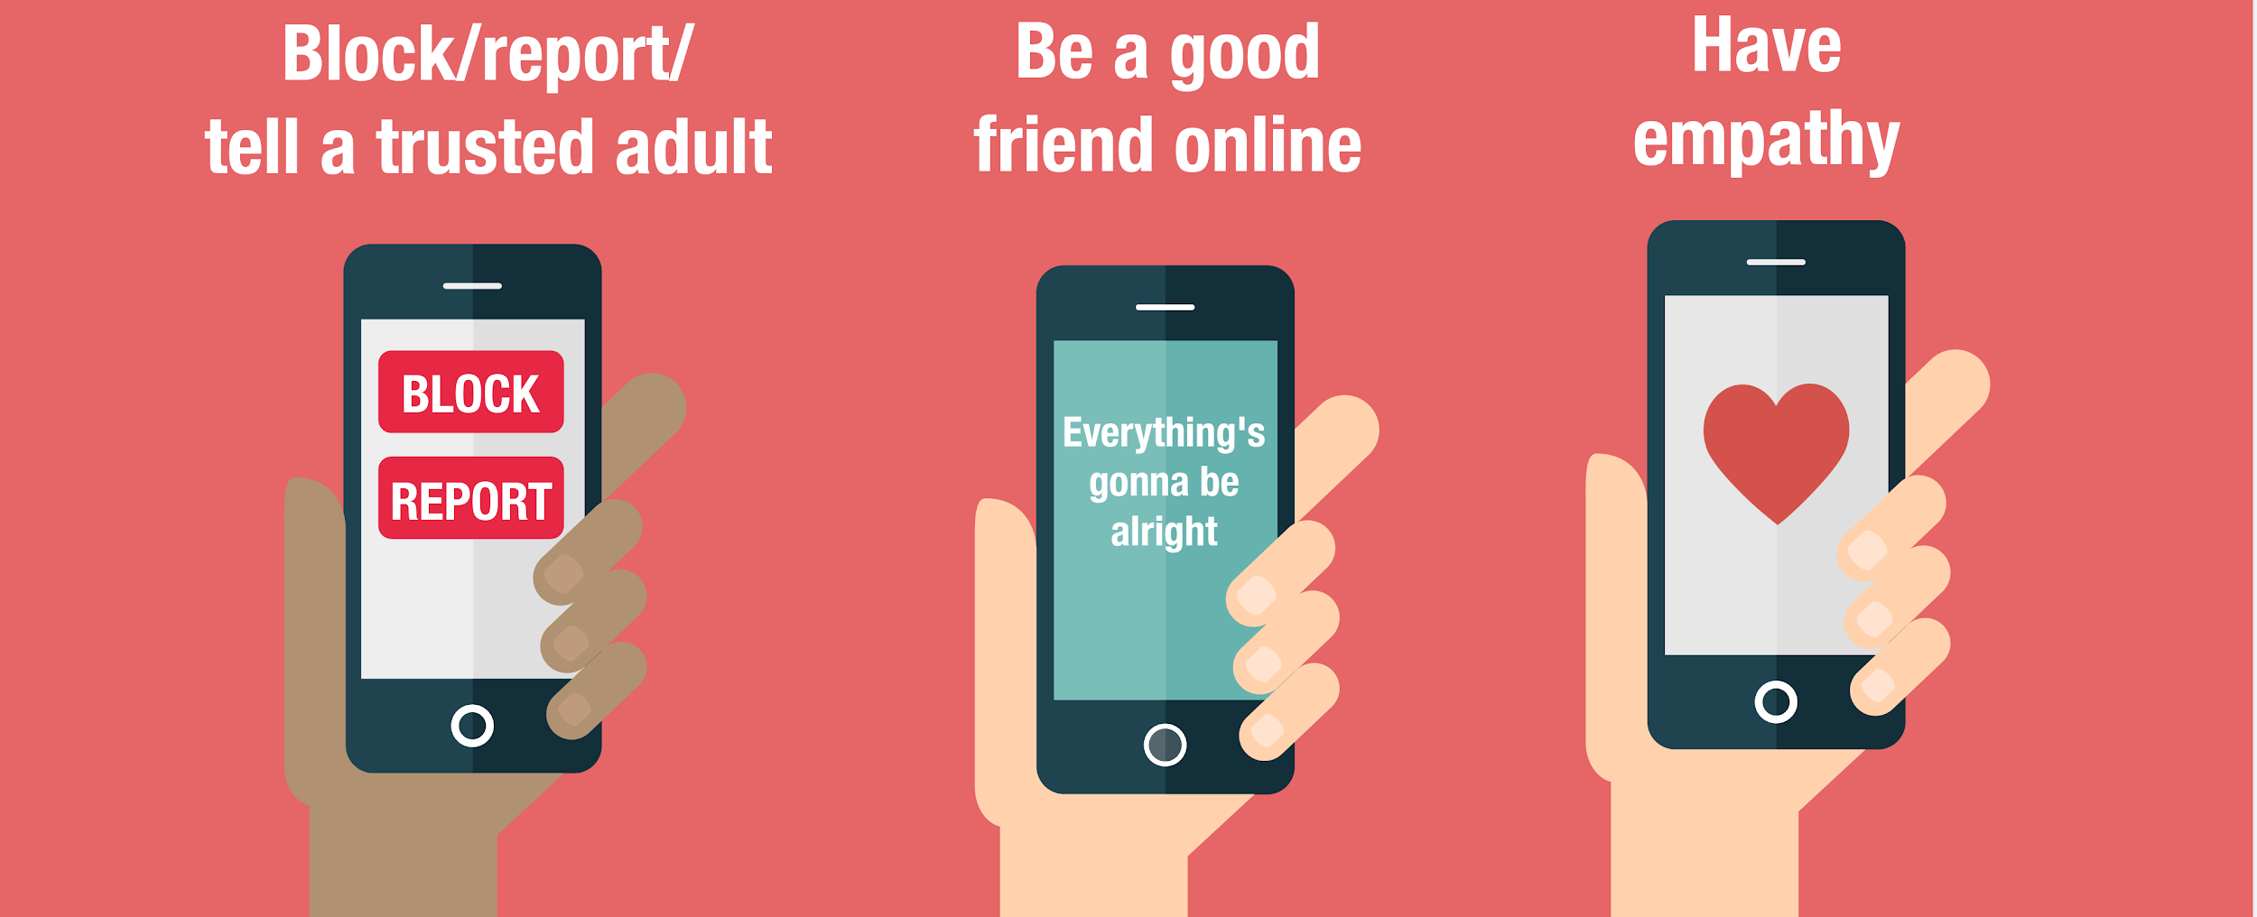
Be an upstander
Animation video (1 min)

Slide 19
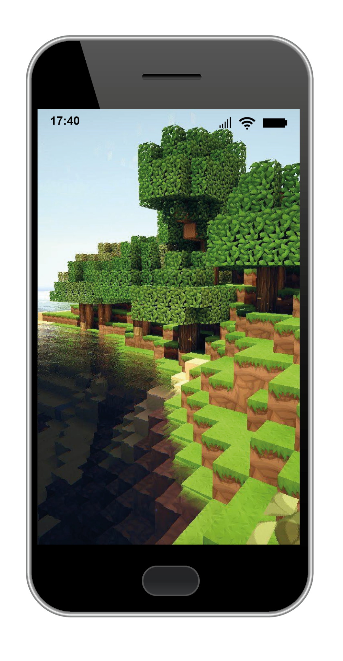
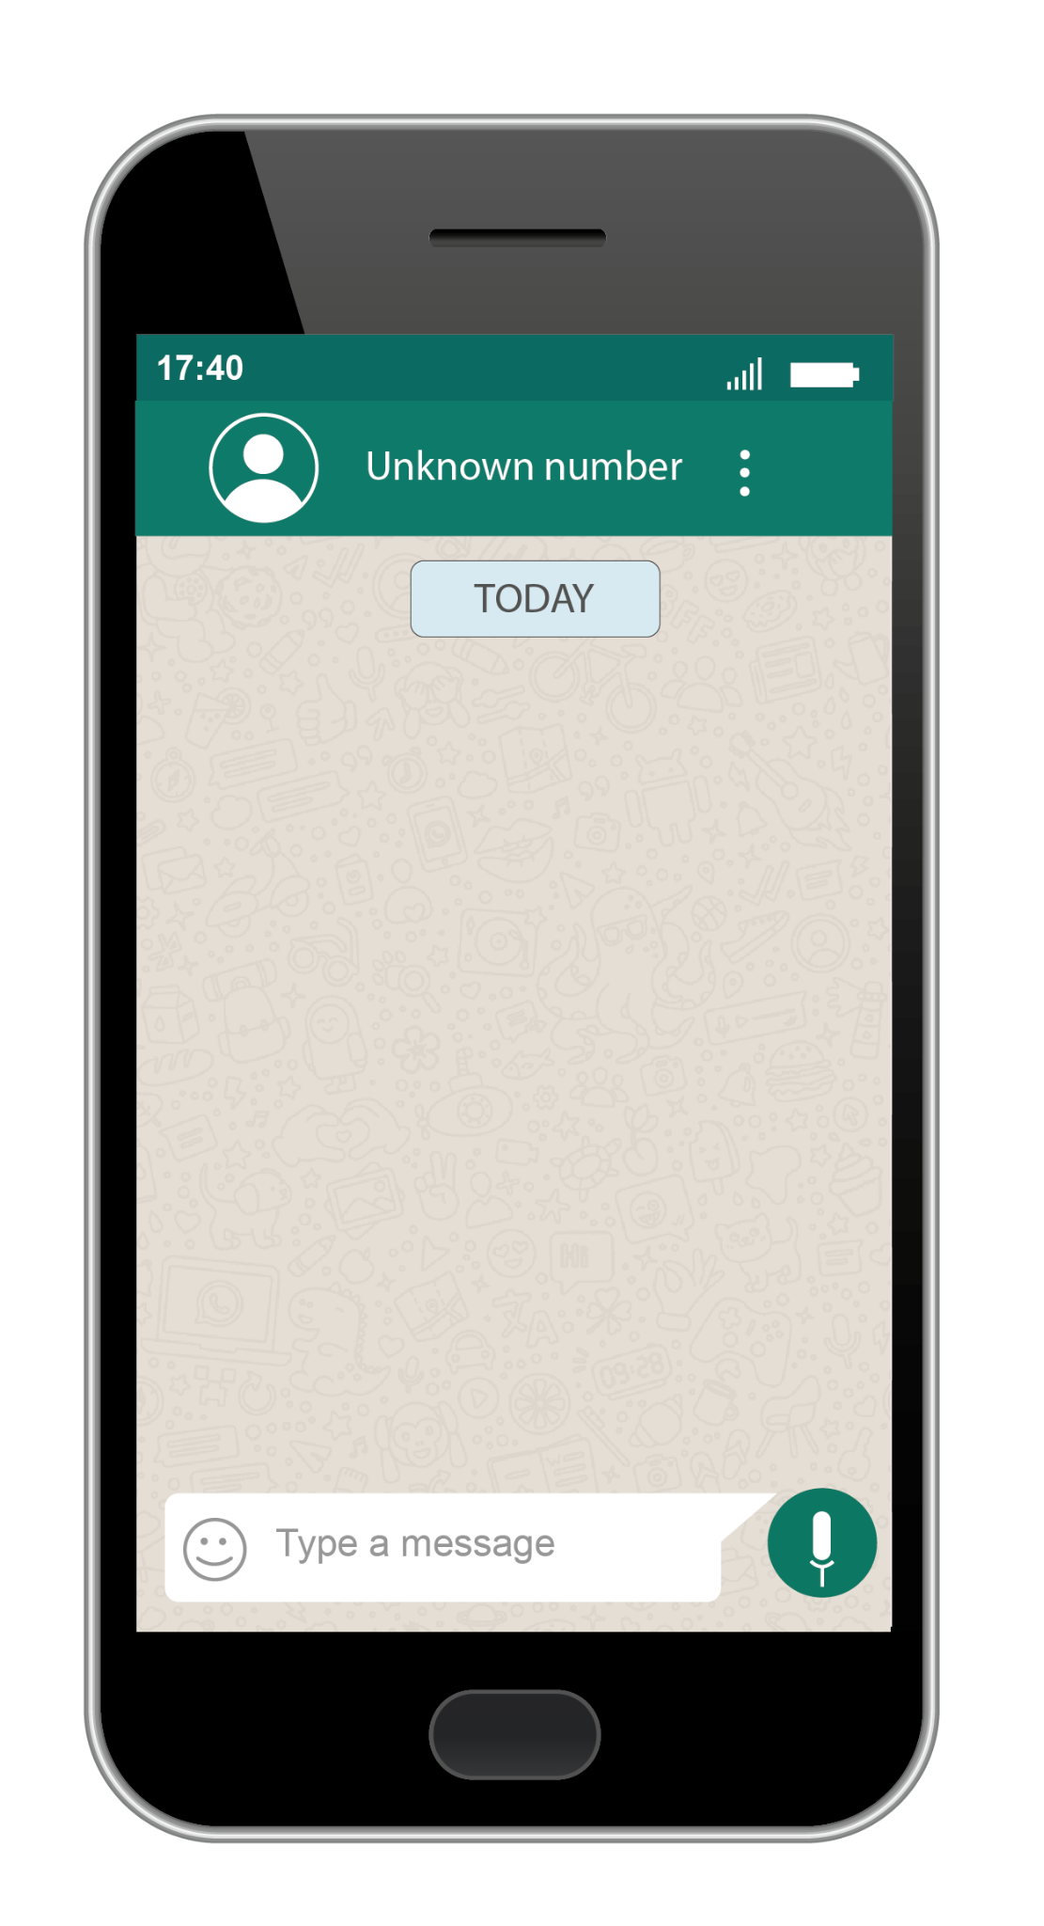
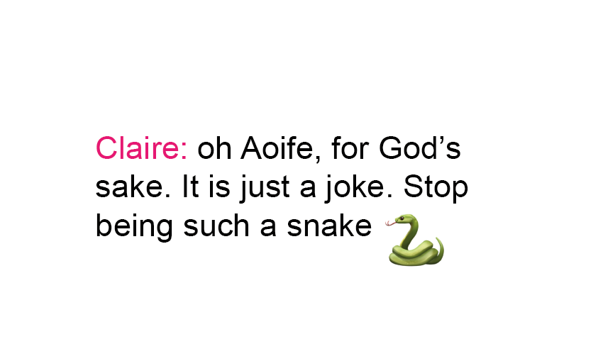
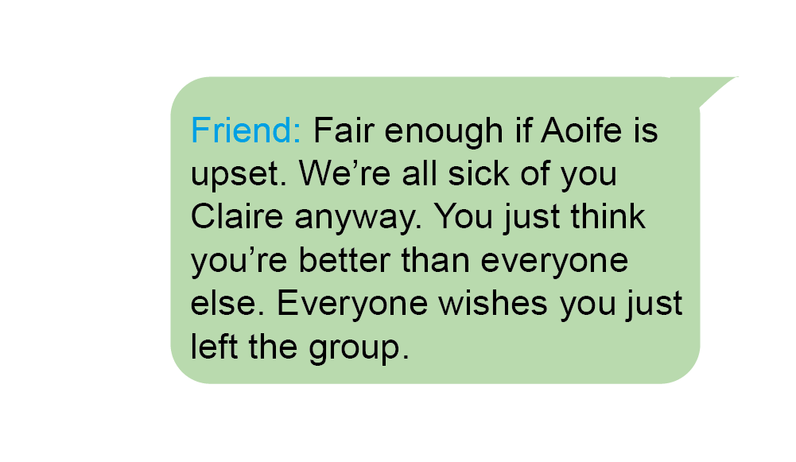
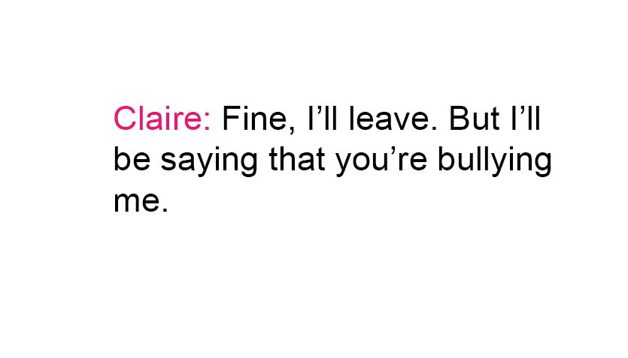
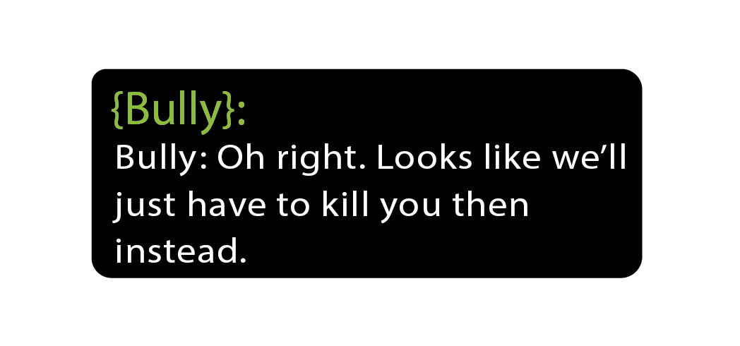
What would you do?
Video game scenario (Bad example of how to intervene)
Whatsapp scenario Bad example of how to intervene

Slide 20
Do activity 4 on your worksheet
How I would intervene...

Slide 21
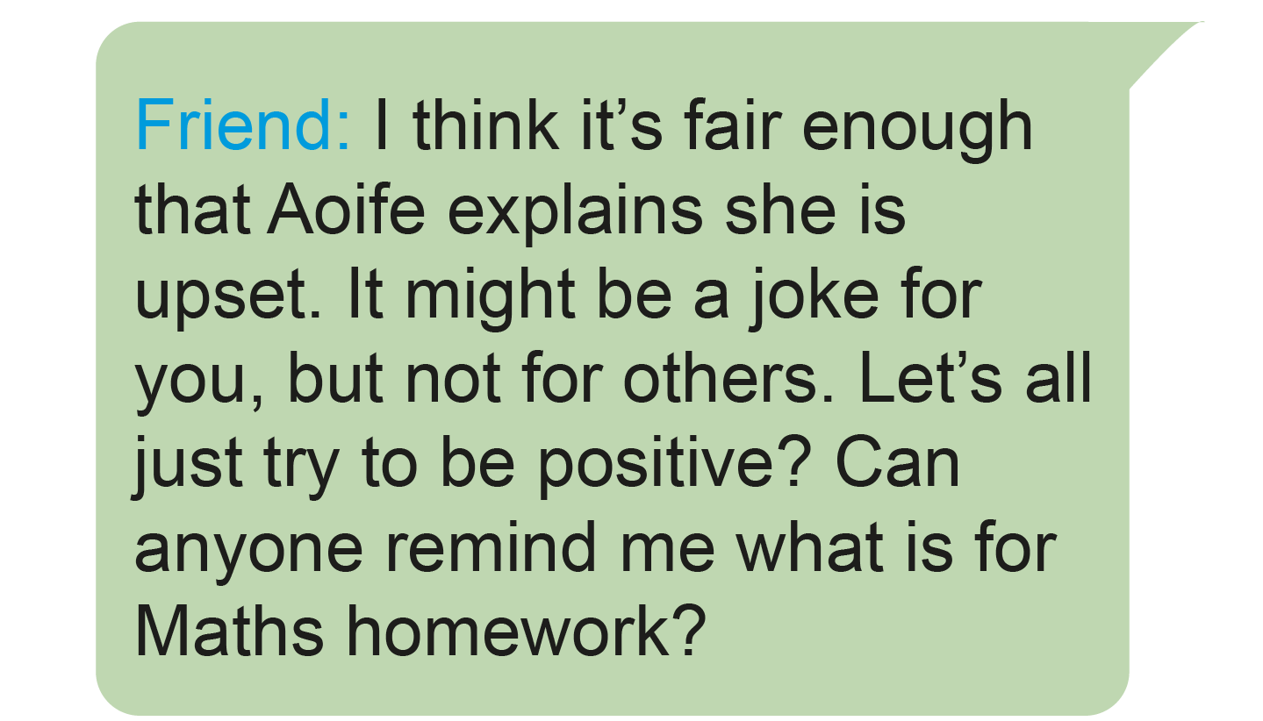
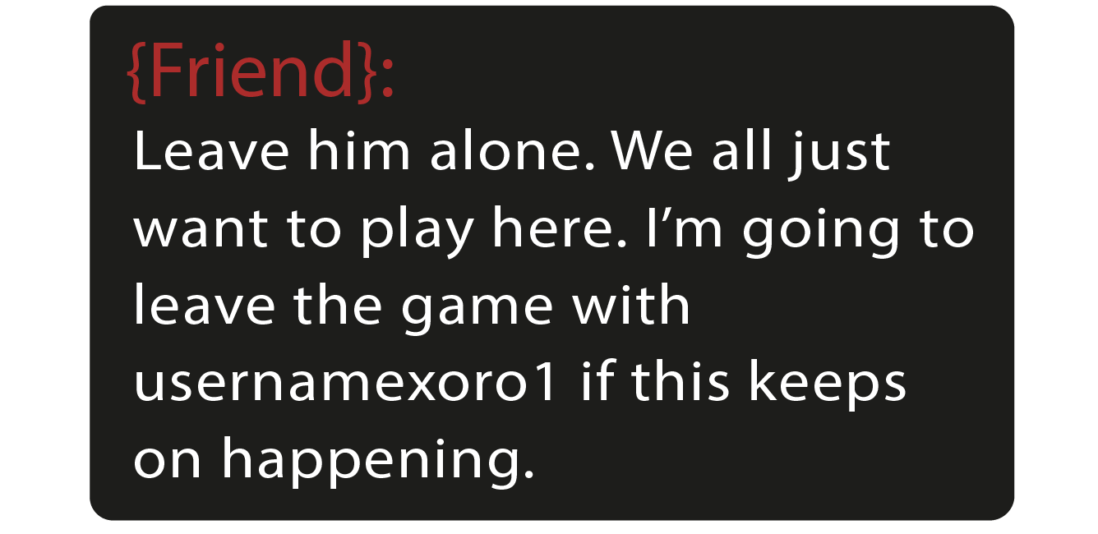
What would you do?
Video game scenario- Good example of how to intervene
Whatsapp scenario- Good example of how to intervene

Slide 22
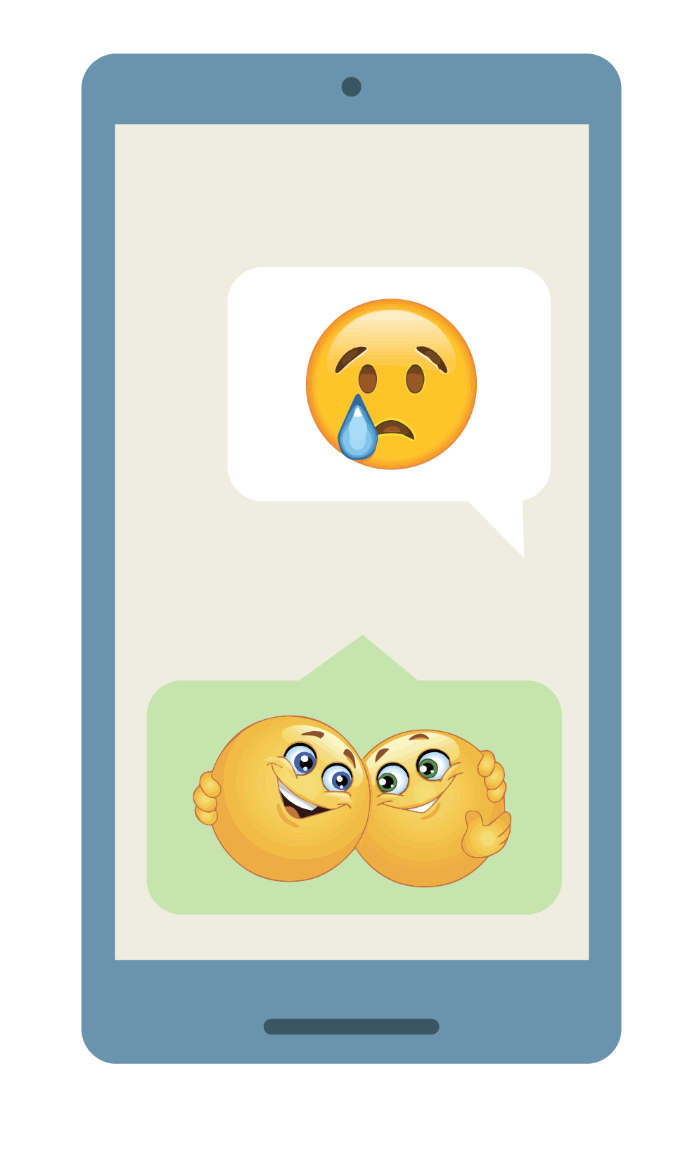
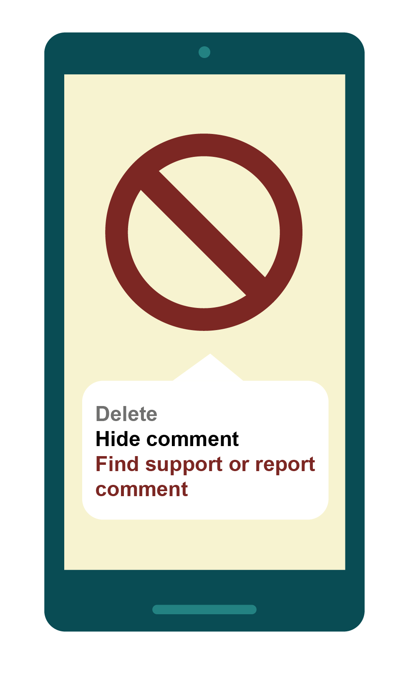
Upstander?
1
Unlike, unfollow
2
Send a positive public message
3
Stay calm, don’t post when you’re angry. Speak face to face when possible.
4
Send a private message to contact
5
Help report and block
6
Tell a trusted adult

Slide 23
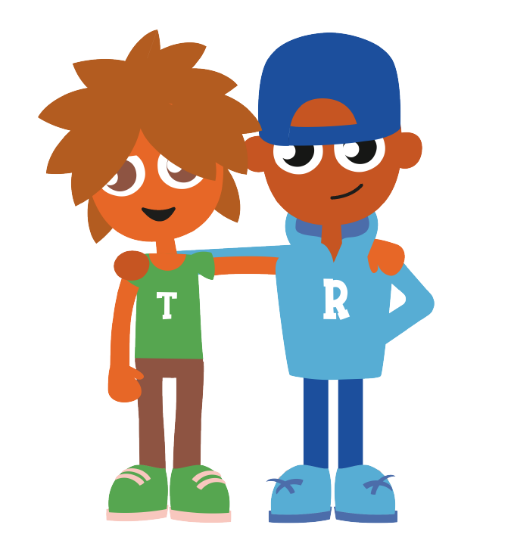
Reach out and be kind
In a world where you can be anything...
Be kind!

Slide 24
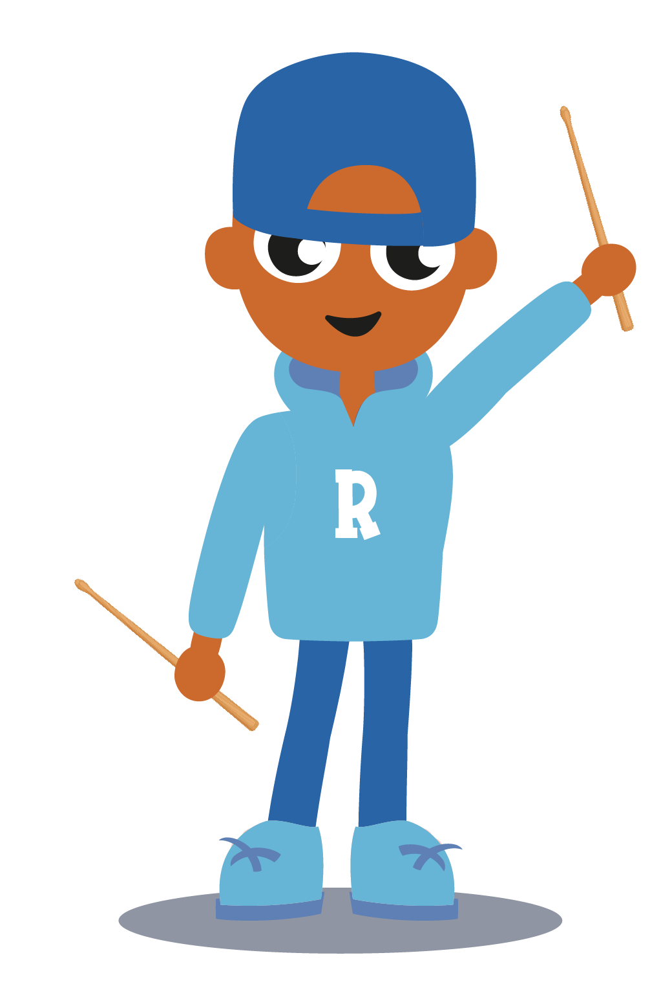
Top tips:
Count to 10; don’t post when you’re angry, speak in person
Think before you post; things can be misunderstood online
Be a good friend online; be an upstander not a bystander
Reach out and be kind; block and report hate online
Bullying and online bullying is repeated and on purpose, it can ruin lives, BE KIND ONLINE

Slide 25
CHY 6015 \ RCN 20010027

Slide 26
g.co/BeInternetLegends-ie

